Slide 1

PowerPoint Lectures for
Principles of Microeconomics, 9e
By
Karl E. Case,
Ray C. Fair &
Sharon M. Oster
; ;

Slide 2


Slide 3
The Economic
Problem: Scarcity
and Choice
Prepared by:
Fernando & Yvonn Quijano

Slide 4


The Economic
Problem: Scarcity
and Choice
PART I INTRODUCTION TO ECONOMICS
2
CHAPTER OUTLINE
Scarcity, Choice, and
Opportunity Cost
Scarcity and Choice in a One- Person Economy
Scarcity and Choice in an Economy of Two or More
The Production Possibility Frontier
The Economic Problem
Economic Systems
Command Economies
Laissez-Faire Economies:
The Free Market
Mixed Systems, Markets, and Governments
Looking Ahead

Slide 5
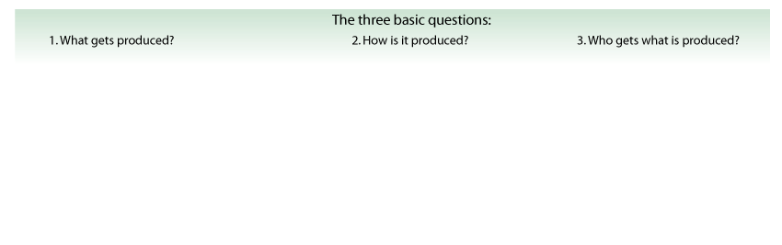


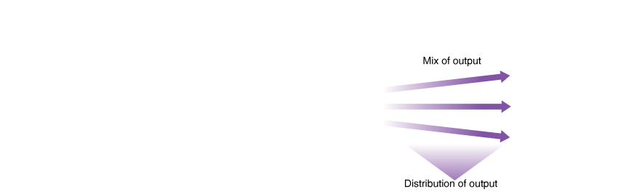

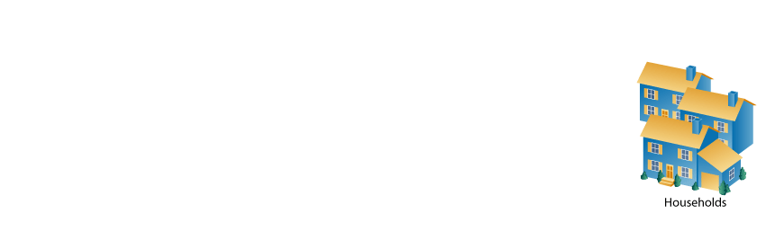
The Economic Problem: Scarcity And Choice
② FIGURE 2.1 The Three Basic Questions
Every society has some system or process that transforms its scarce resources into useful goods and services. In doing so, it must decide what gets produced, how it is produced, and to whom it is distributed. The primary resources that must be allocated are land, labor, and capital.

Slide 6
The Economic Problem: Scarcity And Choice
capital Things that are produced and then used in the production of other goods and services.
factors of production (or factors) The inputs into the process of production. Another term for resources.

Slide 7
The Economic Problem: Scarcity And Choice
production The process that transforms scarce resources into useful goods and services.
inputs or resources Anything provided by nature or previous generations that can be used directly or indirectly to satisfy human wants.
outputs Goods and services of value to households.

Slide 8
Scarcity, Choice, And Opportunity Cost
Scarcity and Choice in a One-Person Economy
Nearly all the same basic decisions that characterize complex economies must also be made in a simple economy.

Slide 9

What is the difference between a single-person economy and a more complex economy?
Most decisions that characterize a complex economy don’t have to be made by an economy with a single person.
Most resources that are scarce in a complex economy are usually abundant in a simple economy.
c. In a single-person economy, the concept of opportunity cost does not apply.
d. In a single-person economy, the mechanics of decision making are simpler than those of a more complex economy.
e. All of the above.

Slide 10
What is the difference between a single-person economy and a more complex economy?
Most decisions that characterize a complex economy don’t have to be made by an economy with a single person.
Most resources that are scarce in a complex economy are usually abundant in a simple economy.
c. In a single-person economy, the concept of opportunity cost does not apply.
d. In a single-person economy, the mechanics of decision making are simpler than those of a more complex economy.
e. All of the above.

Slide 11
Scarcity, Choice, And Opportunity Cost
Scarcity and Choice in a One-Person Economy
Opportunity Cost
The concepts of constrained choice and scarcity are central to the discipline of economics.
opportunity costs The best alternative that we give up, or forgo, when we make a choice or decision.

Slide 12
Using a day at the beach as an example, what is the opportunity cost of leisure?
a. Leisure is free. For example, you don’t have to pay for the benefit of enjoying the sun or relaxing at the beach.
b. Leisure has an opportunity cost only if there is a cost associated with it. For example, entering the beach may require you to pay a fee.
c. The opportunity cost of leisure at the beach is the value of the things that you could have produced during the time you were at the beach. For example, you could have used the time to work and earn some money.
d. According to economists, leisure activities are the only activities that do not carry an opportunity cost.

Slide 13
Using a day at the beach as an example, what is the opportunity cost of leisure?
a. Leisure is free. For example, you don’t have to pay for the benefit of enjoying the sun or relaxing at the beach.
b. Leisure has an opportunity cost only if there is a cost associated with it. For example, entering the beach may require you to pay a fee.
c. The opportunity cost of leisure at the beach is the value of the things that you could have produced during the time you were at the beach. For example, you could have used the time to work and earn some money.
d. According to economists, leisure activities are the only activities that do not carry an opportunity cost.

Slide 14

Scarcity, Choice, And Opportunity Cost
Scarcity and Choice in a One-Person Economy
Opportunity Cost
Frozen Foods and
Opportunity Costs
The growth of the frozen dinner entrée market in the last 50 years is a good example of the role of opportunity costs in our lives.

Slide 15
Scarcity, Choice, And Opportunity Cost
Scarcity and Choice in an Economy of Two or More
Specialization, Exchange, and Comparative Advantage
theory of comparative advantage Ricardo’s theory that specialization and free trade will benefit all trading parties, even those that may be “absolutely” more efficient producers.

Slide 16
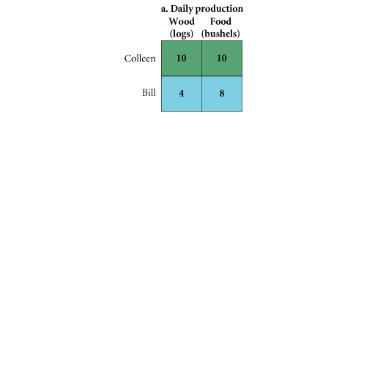
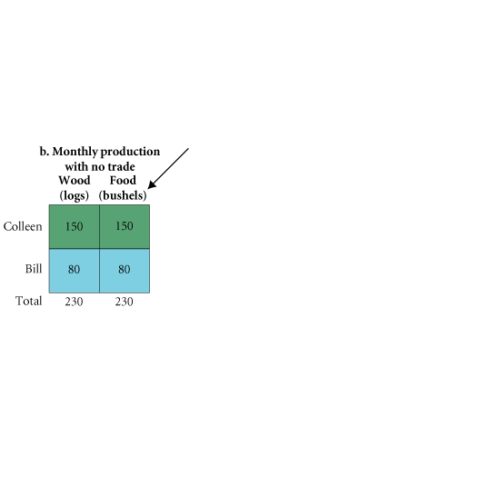
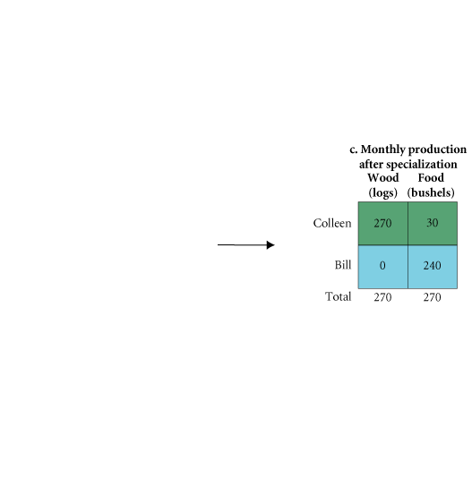
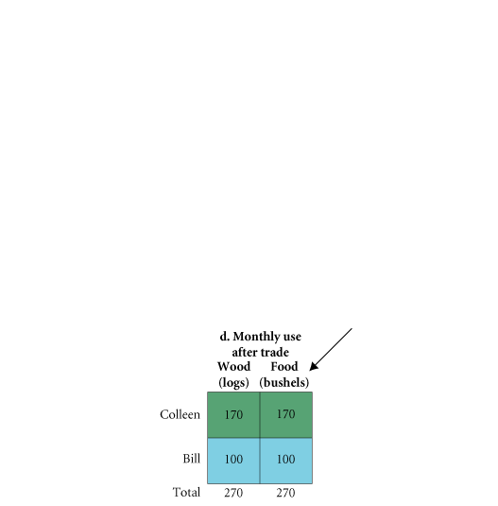
Scarcity, Choice, And Opportunity Cost
Scarcity and Choice in an Economy of Two or More
④ FIGURE 2.2 Comparative Advantage and the Gains from Trade
In this figure, (a) shows the number of logs and bushels of food that Colleen and Bill can produce for every day spent at the task
and (b) shows how much output they could produce in a month, assuming they wanted an equal number of logs and bushels. Colleen would split her time 50/50, devoting 15 days to each task and achieving total output of 150 logs and 150 bushels of food. Bill would spend 20 days cutting wood and 10 days gathering food.
As shown in (c) and (d), by specializing and trading, both Colleen and Bill will be better off. Going from (c) to (d), Colleen trades 100 logs to Bill in exchange for 140 bushels of food.

Slide 17
Scarcity, Choice, And Opportunity Cost
Scarcity and Choice in an Economy of Two or More
Specialization, Exchange, and Comparative Advantage
absolute advantage A producer has an absolute advantage over another in the production of a good or service if he or she can produce that product using fewer resources.
comparative advantage A producer has a comparative advantage over another in the production of a good or service if he or she can produce that product at a lower opportunity cost.

Slide 18
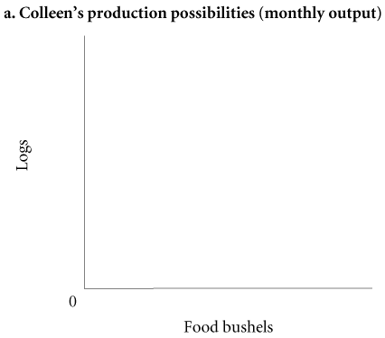

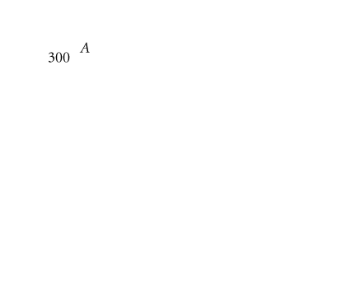
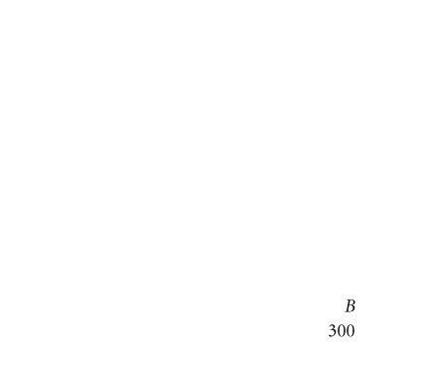
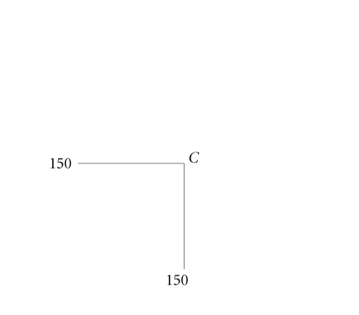
Scarcity, Choice, And Opportunity Cost
Scarcity and Choice in an Economy of Two or More
A Graphical Presentation of Comparative Advantage and Gains from Trade
④ FIGURE 2.3a Production Possibilities with No Trade
The figure in (a) shows all of the combinations of logs and bushels of food that Colleen can produce by herself. If she spends all 30 days each month on logs, she produces 300 logs and no food (point A).
If she spends all 30 days on food, she produces 300 bushels of food and no logs (point B).
If she spends 15 days on logs and 15 days on food, she produces 150 of each (point C).

Slide 19
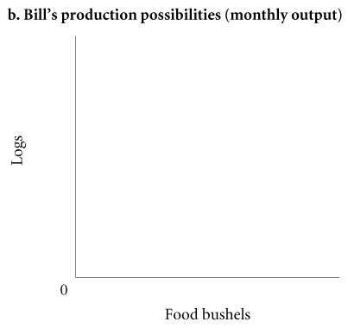

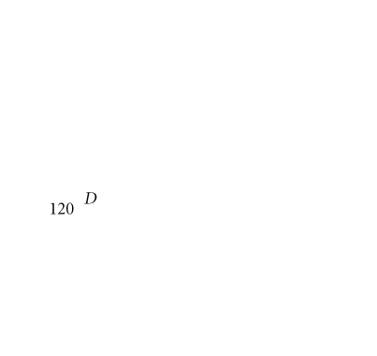
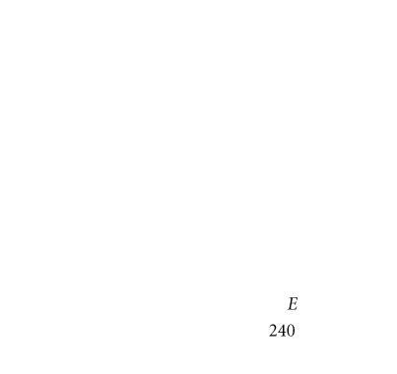
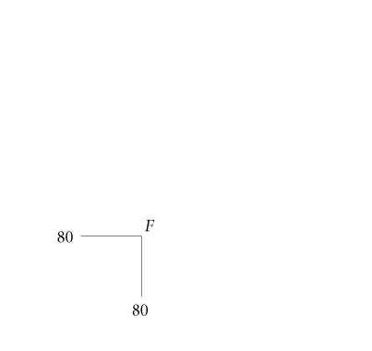
Scarcity, Choice, And Opportunity Cost
Scarcity and Choice in an Economy of Two or More
A Graphical Presentation of Comparative Advantage and Gains from Trade
④ FIGURE 2.3b Production Possibilities with No Trade
The figure in (b) shows all of the combinations of logs and bushels of food that Bill can produce by himself. If he spends all 30 days each month on logs, he produces 120 logs and no food (point D).
If he spends all 30 days on food, he produces 240 bushels of food and no logs (point E).
If he spends 20 days on logs and 10 days on food, he produces 80 of each (point F).

Slide 20
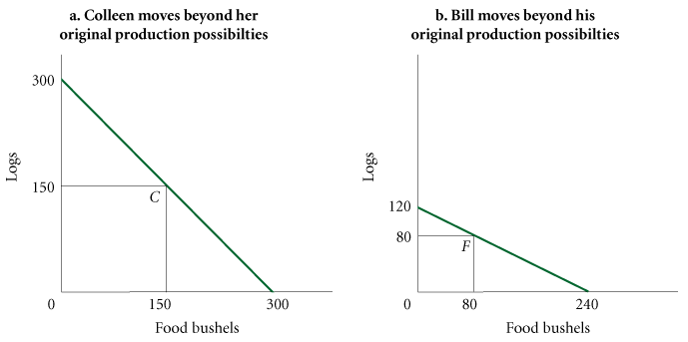
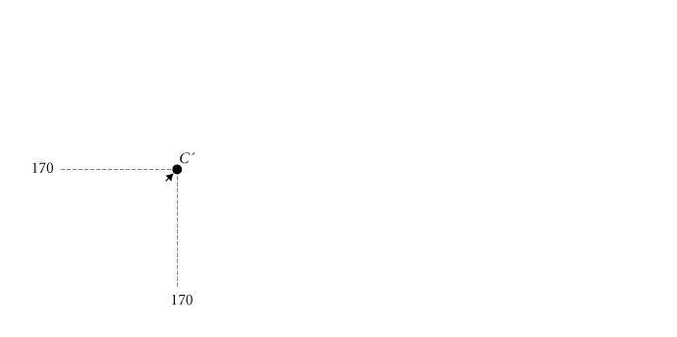
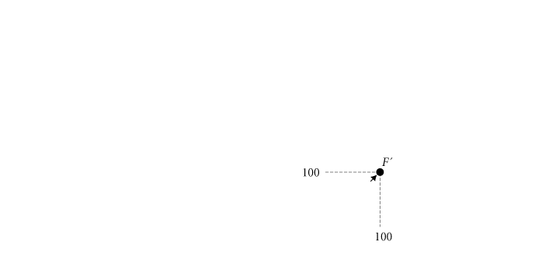
Scarcity, Choice, And Opportunity Cost
Scarcity and Choice in an Economy of Two or More
① FIGURE 2.4 Colleen and Bill Gain from Trade
By specializing and engaging in trade, Colleen and Bill can move beyond their own production possibilities. If Bill spends all his time producing food, he will produce 240 bushels of food and no logs. If he can trade 140 of his bushels of food to Colleen for 100 logs, he will end up with 100 logs and 100 bushels of food. The figure in (b) shows that he can move from point F to point F'.
If Colleen spends 27 days cutting logs and 3 days producing food, she will produce 270 logs and 30 bushels of food. If she can trade 100 of her logs to Bill for 140 bushels of food, she will end up with 170 logs and 170 bushels of food. The figure in (a) shows that she can move from point C to point C'.

Slide 21
Scarcity, Choice, And Opportunity Cost
Scarcity and Choice in an Economy of Two or More
Weighing Present and Expected Future Costs and Benefits
We trade off present and future benefits in small ways all the time.

Slide 22
Scarcity, Choice, And Opportunity Cost
Scarcity and Choice in an Economy of Two or More
Capital Goods and Consumer Goods
consumer goods Goods produced for present consumption.
investment The process of using resources to produce new capital.

Slide 23
Scarcity, Choice, And Opportunity Cost
The Production Possibility Frontier
production possibility frontier (ppf) A graph that shows all the combinations of goods and services that can be produced if all of society’s resources are used efficiently.

Slide 24

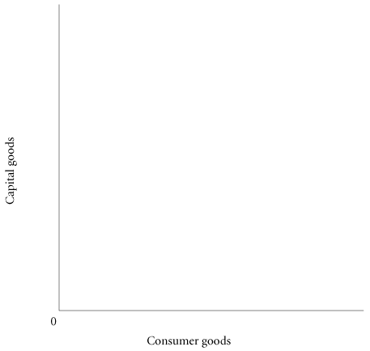


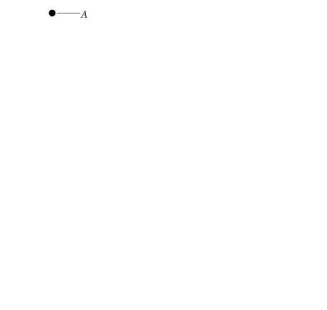
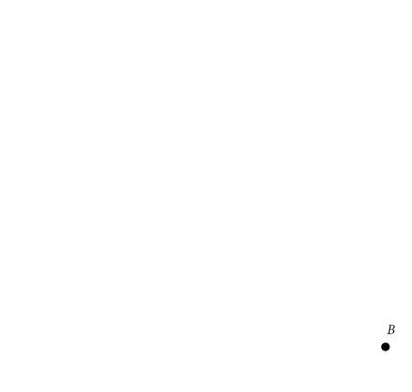
Scarcity, Choice, And Opportunity Cost
The Production Possibility Frontier
All points below and to the left of the curve (the shaded area) represent combinations of capital and consumer goods that are possible for the society given the resources available and existing technology.
Points above and to the right of the curve, such as point G, represent combinations that cannot be reached.
If an economy were to end up at point A on the graph, it would be producing no consumer goods at all; all resources would be used for the production of capital. If an economy were to end up at point B, it would produce only consumer goods.

Slide 25
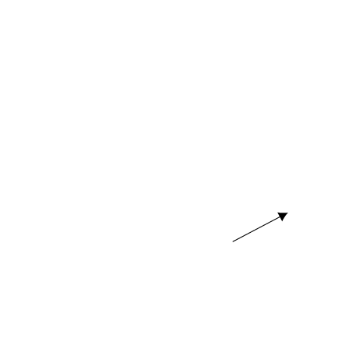

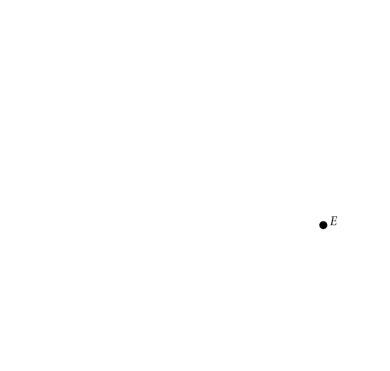
Scarcity, Choice, And Opportunity Cost
The Production Possibility Frontier
Although an economy may be operating with full employment of its land, labor, and capital resources, it may still be operating inside its ppf, at a point such as D. The economy could be using those resources inefficiently.
Periods of unemployment also correspond to points inside the ppf, such as point D.
Moving onto the frontier from a point such as D means achieving full employment of resources.

Slide 26
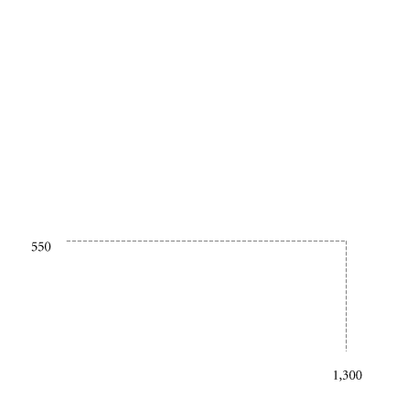
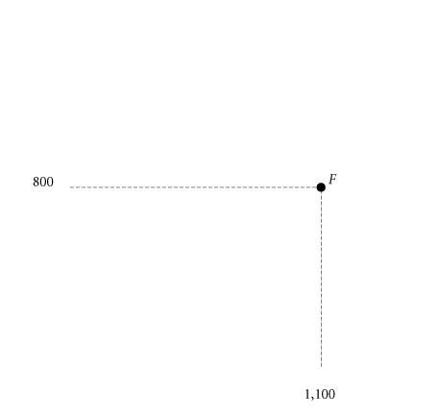
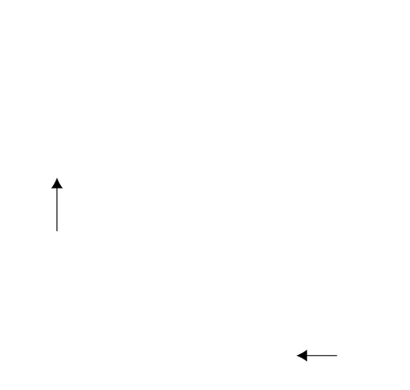
Scarcity, Choice, And Opportunity Cost
The Production Possibility Frontier
④ FIGURE 2.5 Production Possibility Frontier
The ppf illustrates a number of economic concepts. One of the most important is opportunity cost. The opportunity cost of producing more capital goods is fewer consumer goods.
Moving from E to F, the number of capital goods increases from 550 to 800, but the number of consumer goods decreases from 1,300 to 1,100.

Slide 27
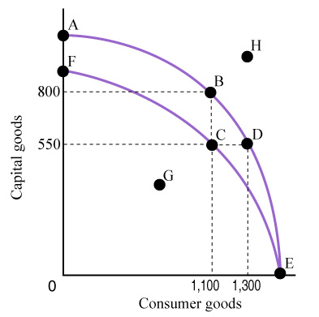
Consider the figure below. As this country moves from point D to point B along the production possibility frontier AE,
a. the opportunity cost of building more consumer goods rises.
b. the opportunity cost of building more capital goods rises.
c. the opportunity cost is not affected because the curve does not shift.
d. the opportunity cost of producing more of either consumer goods or capital goods rises.

Slide 28
Consider the figure below. As this country moves from point D to point B along the production possibility frontier AE,
a. the opportunity cost of building more consumer goods rises.
b. the opportunity cost of building more capital goods rises.
c. the opportunity cost is not affected because the curve does not shift.
d. the opportunity cost of producing more of either consumer goods or capital goods rises.

Slide 29
Scarcity, Choice, And Opportunity Cost
The Production Possibility Frontier
Unemployment
During economic downturns or recessions, industrial plants run at less than their total capacity. When there is unemployment of labor and capital, we are not producing all that we can.

Slide 30
Scarcity, Choice, And Opportunity Cost
The Production Possibility Frontier
Inefficiency
Waste and mismanagement are the results of a firm’s operating below its potential.
Sometimes, inefficiency results from mismanagement of the economy instead of mismanagement of individual private firms.

Slide 31
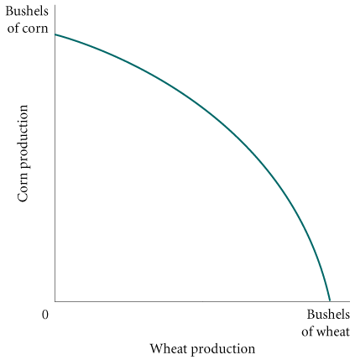

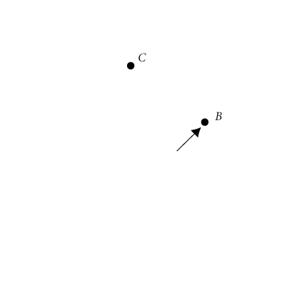
Scarcity, Choice, And Opportunity Cost
The Production Possibility Frontier
Inefficiency
④ FIGURE 2.6 Inefficiency from
Misallocation of Land in Farming
Society can end up inside its ppf at a point such as A by using its resources inefficiently.
If, for example, Ohio’s climate and soil were best suited for corn production and those of Kansas were best suited for wheat production, a law forcing Kansas farmers to produce corn and Ohio farmers to produce wheat would result in less of both. In such a case, society might be at point A instead of point B.

Slide 32
Scarcity, Choice, And Opportunity Cost
The Production Possibility Frontier
The Efficient Mix of Output
To be efficient, an economy must produce what people want.
Negative Slope and Opportunity Cost
marginal rate of transformation (MRT) The slope of the production possibility frontier (ppf).

Slide 33
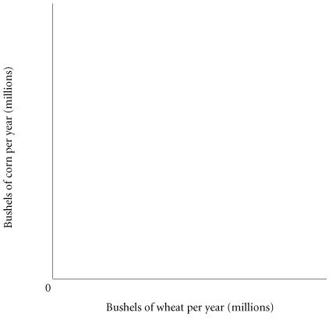

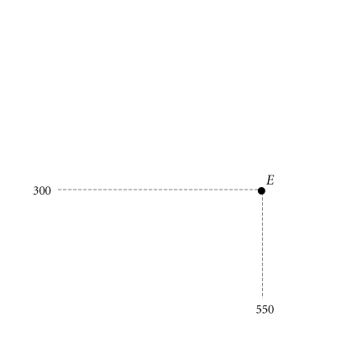
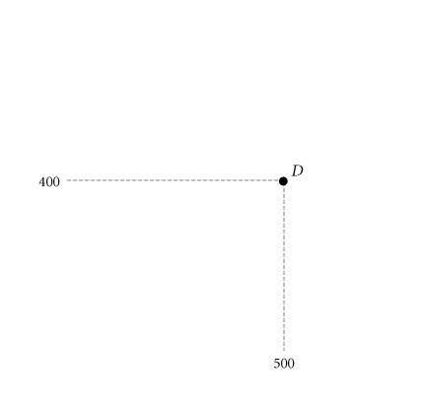
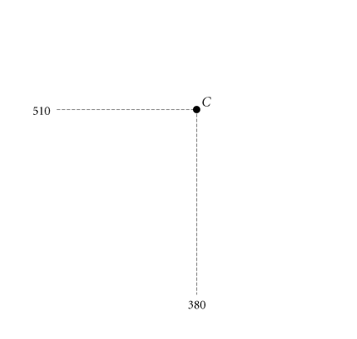
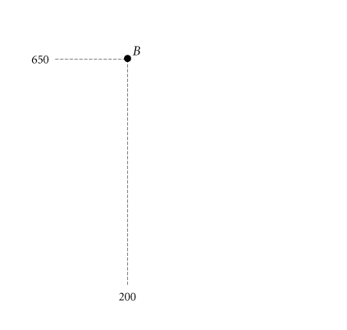
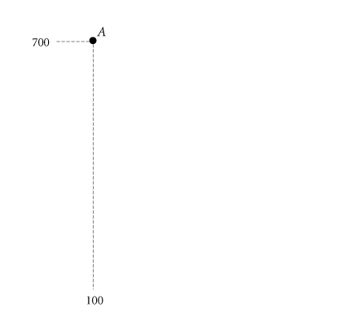
Scarcity, Choice, And Opportunity Cost
The Production Possibility Frontier
The Law of Increasing Opportunity Cost
TABLE 2.1 Production Possibility Schedule for Total Corn and Wheat Production in Ohio and Kansas
Point on ppf | Total Corn Production (Millions of Bushels Per Year) | Total Wheat Production (Millions of Bushels Per Year)
A | 700 | 100
B | 650 | 200
C | 510 | 380
D | 400 | 500
E | 300 | 550
④ FIGURE 2.7 Corn and Wheat Production in Ohio and Kansas
The ppf illustrates that the opportunity cost of corn production increases as we shift resources from wheat production to corn production. Moving from point E to D, we get an additional 100 million bushels of corn at a cost of 50 million bushels of wheat.
Moving from point B to A, we get only 50 million bushels of corn at a cost of 100 million bushels of wheat. The cost per bushel of corn— measured in lost wheat— has increased.

Slide 34
Scarcity, Choice, And Opportunity Cost
The Production Possibility Frontier
Economic Growth
economic growth An increase in the total output of an economy. It occurs when a society acquires new resources or when it learns to produce more using existing resources.

Slide 35
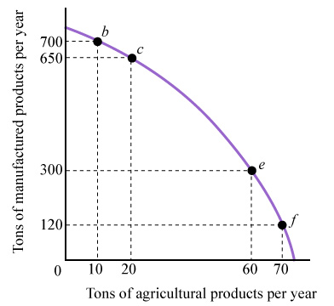
Refer to the figure. A 10-ton increase in the production of farm goods requires a sacrifice of manufactured goods that is:
a. greater between points b and c than between points e and f.
b. greater between points e and f than between points b and c.
c. proportionally the same between any two points.
d. less and less as you move downward along the curve.

Slide 36
Refer to the figure. A 10-ton increase in the production of farm goods requires a sacrifice of manufactured goods that is:
a. greater between points b and c than between points e and f.
b. greater between points e and f than between points b and c.
c. proportionally the same between any two points.
d. less and less as you move downward along the curve.

Slide 37
Scarcity, Choice, And Opportunity Cost
The Production Possibility Frontier
Economic Growth
TABLE 2.2 Increasing Productivity in Corn and Wheat Production in the United States, 1935–2007
 | CORN |  | WHEAT
 | Yield Per Acre (Bushels) | Labor Hours Per 100 Bushels | Yield Per Acre (Bushels) | Labor Hours Per 100 Bushels
1935–1939 1945–1949 1955–1959 1965–1969 1975–1979 1981–1985 1985–1990 1990–1995 1998 2001 2006 2007 | 26.1 36.1 48.7 78.5 95.3 107.2 112.8 120.6 134.4 138.2 145.6 152.8 | 108 53 20 7 4 3 NAª NAª NAª NAª NAª NAª | 13.2 16.9 22.3 27.5 31.3 36.9 38.0 38.1 43.2 43.5 42.3 40.6 | 67 34 17 11 9 7 NAª NAª NAª NAª NAª NAª
ª Data not available.

Slide 38
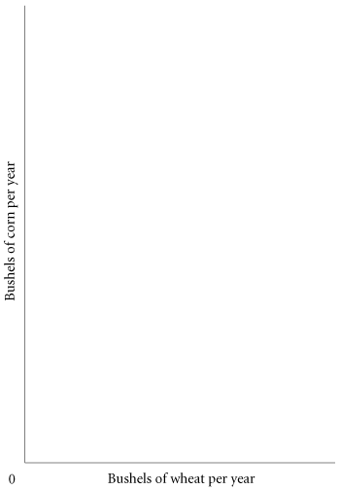
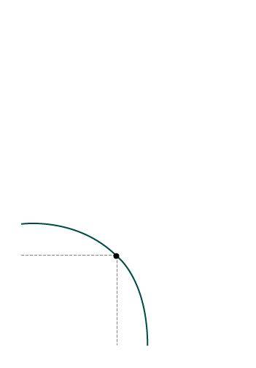
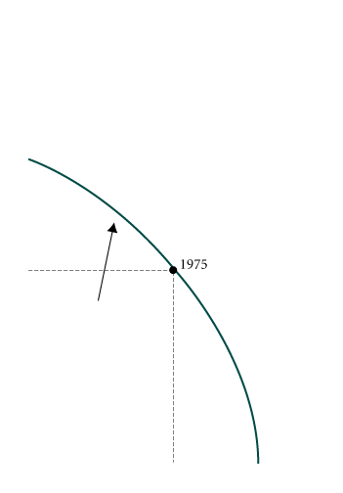
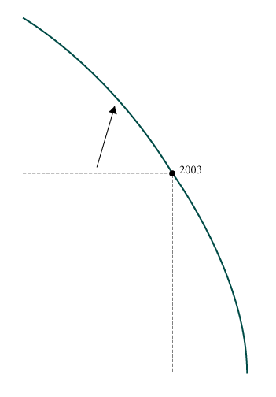
Scarcity, Choice, And Opportunity Cost
The Production Possibility Frontier
Economic Growth
④ FIGURE 2.8 Economic Growth Shifts the PPF Up and to the Right
Productivity increases have enhanced the ability of the United States to produce both corn and wheat. As Table 2.2 shows, productivity increases were more dramatic for corn than for wheat. Thus, the shifts in the ppf were not parallel.
Note: The ppf also shifts if the amount of land or labor in corn and wheat production changes. Although we emphasize productivity increases here, the actual shifts between years were due in part to land and labor changes.

Slide 39
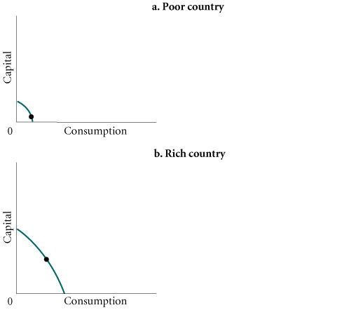
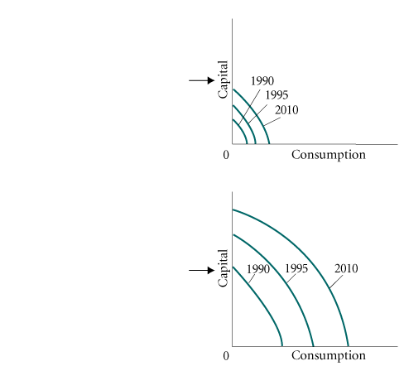
Scarcity, Choice, And Opportunity Cost
The Production Possibility Frontier
Sources of Growth and the Dilemma of Poor Countries
④ FIGURE 2.9 Capital Goods and Growth in Poor and Rich Countries
Rich countries find it easier than poor countries to devote resources to the production of capital, and the more resources that flow into capital production, the faster the rate of economic growth.
Thus, the gap between poor and rich countries has grown over time.

Slide 40
Scarcity, Choice, And Opportunity Cost
The Economic Problem
Recall the three basic questions facing all economic systems:
(1) What gets produced?
(2) How is it produced?
(3) Who gets it?
Given scarce resources, how do large, complex societies go about answering the three basic economic questions?

Slide 41
Economic Systems
Command Economies
command economy An economy in which a central government either directly or indirectly sets output targets, incomes, and prices.

Slide 42
Economic Systems
Laissez-faire Economies: The Free Market
laissez-faire economy Literally from the French: “allow [them] to do.” An economy in which individual people and firms pursue their own self-interest without any central direction or regulation.
market The institution through which buyers and sellers interact and engage in exchange.
Some markets are simple and others are complex, but they all involve buyers and sellers engaging in exchange. The behavior of buyers and sellers in a laissez-faire economy determines what gets produced, how it is produced, and who gets it.

Slide 43
A market exists primarily in what type of economic system?
a. A command economy.
b. A laissez-faire economy.
c. A democracy.
d. A dictatorship.
e. An economy in transition.

Slide 44
A market exists primarily in what type of economic system?
a. A command economy.
b. A laissez-faire economy.
c. A democracy.
d. A dictatorship.
e. An economy in transition.

Slide 45
Economic Systems
Laissez-faire Economies: The Free Market
Consumer Sovereignty
consumer sovereignty The idea that consumers ultimately dictate what will be produced (or not produced) by choosing what to purchase (and what not to purchase).

Slide 46
Economic Systems
Laissez-faire Economies: The Free Market
Individual Production Decisions: Free Enterprise
free enterprise The freedom of individuals to start and operate private businesses in search of profits.

Slide 47
Economic Systems
Laissez-faire Economies: The Free Market
Distribution of Output
The amount that any one household gets depends on its income and wealth.
Income is the amount that a household earns each year. It comes in a number of forms: wages, salaries, interest, and the like.
Wealth is the amount that households have accumulated out of past income through saving or inheritance.

Slide 48
Which of the following problems are typical of a market system?
a. The market system does not always produce what people want at the lowest possible cost.
b. The market system offers rewards (income) that may be unfairly distributed, and some groups may be left out.
c. Periods of unemployment and inflation recur with some regularity.
d. All of the above.
e. None of the above.

Slide 49
Which of the following problems are typical of a market system?
a. The market system does not always produce what people want at the lowest possible cost.
b. The market system offers rewards (income) that may be unfairly distributed, and some groups may be left out.
c. Periods of unemployment and inflation recur with some regularity.
d. All of the above.
e. None of the above.

Slide 50
Economic Systems
Laissez-faire Economies: The Free Market
Price Theory
In a free market system, the basic economic questions are answered without the help of a central government plan or directives. This is what the “free” in free market means—the system is left to operate on its own with no outside interference. Individuals pursuing their own self-interest will go into business and produce the products and services that people want. Other individuals will decide whether to acquire skills; whether to work; and whether to buy, sell, invest, or save the income that they earn. The basic coordinating mechanism is price.

Slide 51
Economic Systems
Mixed Systems, Markets, And Governments
The differences between command economies and laissez-faire economies in their pure forms are enormous. In fact, these pure forms do not exist in the world; all real systems are in some sense “mixed.”

Slide 52
REVIEW TERMS AND CONCEPTS
absolute advantage
capital
command economy
comparative advantage
consumer goods
consumer sovereignty
economic growth
factors of production (or factors)
free enterprise
inputs or resources
investments
laissez-faire economy
marginal rate of transformation (MRT)
market
opportunity cost
outputs
production
production possibility frontier (ppf)
theory of comparative advantage

